Slide 1


Sap ABAP on Hana &
s/4hana trainings
Anubhav Oberoy

Slide 2

INTRODUCTION

Slide 3
Agenda – Day 5
Describing Data Objects in SQL Script ( Variables )
Scalar
Array
Tables
Concept of Procedure
Create Procedure
Update Procedure
Delete Procedure
Concept of Cursor
Implicit
Explicit
Making Procedure with parameters
Making Anonymous Block in HANA Database
Describing User Defined Function with HANADB
Reuse Function for SQL queries
--Break--

Slide 4
Agenda - Day 5
What is AMDP
Introduction of AMDP
Implementation of AMDP
Why we use AMDP
Describing Rules for AMDP
Describing New way to Create Structure
Create AMDP for Consume SQL Script in ADT

Slide 5
Data Objects in SQL Script ( Variables )
Data Variables
Scalar
Array
Table Type
Used to store single value
Syntax:
DECLARE varname vtype;
Numbers – INT, BIGINT, TINYINT, DECIMAL
Char – VARCHAR, NVARCHAR, CHAR, STRING
Date – DATE, TIMESTAMP
Other – BLOB, CLOB
List of values of single data type
DECLARE arr datatype ARRAY;
Implicit
Explicit
Item 1
Item 2
…
…
TABLE()
Table type
1

Slide 6
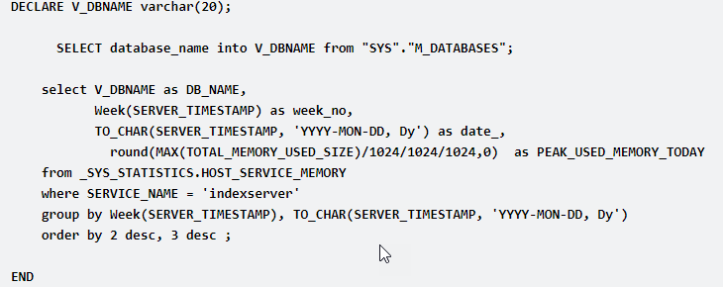
Concept of Procedure
A procedure is a unit/module that perform a specific task. This procedure can be combined to form larger programs. This basically forms the 'Modular Design'. A procedure can be invoked by another procedure which is called the calling program.
Procedures are re-useable processing block with a specific sequence of data transformation. The procedure can have multi-input/output parameters. The procedure can be created as read-only or read-write.

Slide 7
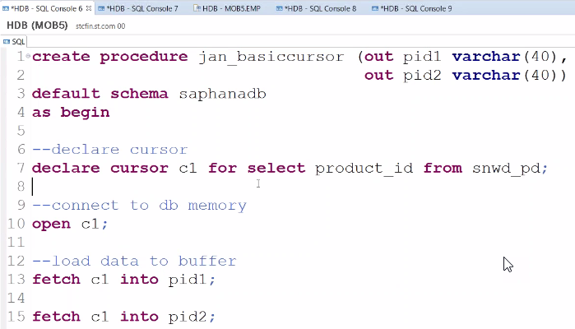
Cursor
Cursor is used to fetch single rows from the result set returned by a query. Cursors can be defined either after the signature of the procedure and before the procedure's body or at the beginning of a block with the DECLARE token. The cursor provides the functionality to iterate through a query result row-by-row.
You can name a cursor so that it could be referred to in a program to fetch and process the rows returned by the SQL statement, one at a time.
There are two types of cursors −
Implicit cursors
Explicit cursors
A cursor is assigned to a query. We can traverse over record by record.
Steps:
Declare
Open
Fetch
Close
Notes:
The sole purpose of an R/3 system is to provide a suite of tightly integrated, large-scale business applications. R/3 comes prepackaged with the core business applications needed by most large corporations. These applications coexist in one homogenous environment. They are designed from the ground up to run using a single database and one (very large) set of tables.
Presentation: It is usually installed on a user's workstation. When started, the presentation server displays the R/3 menus within a window. This window is commonly known as the SAPGUI, or the user interface (or simply, the interface).
Basis : Basis is like an operating system for R/3. It sits between the ABAP/4 code and the computer's operating system. SAP likes to call it middleware because it sits in the middle, between ABAP/4 and the operating system. ABAP/4 cannot run directly on an operating system. It requires a set of programs (collectively called Basis) to load, interpret, and buffer its input and output. Basis provides the runtime environment for ABAP/4 programs.
Database: The database server is a set of executables that accept database requests from the application server. These requests are passed on to the RDBMS (Relation Database Management System). The RDBMS sends the data back to the database server, which then passes the information back to the application server. The application server in turn passes that information to your ABAP/4 program.

Slide 8
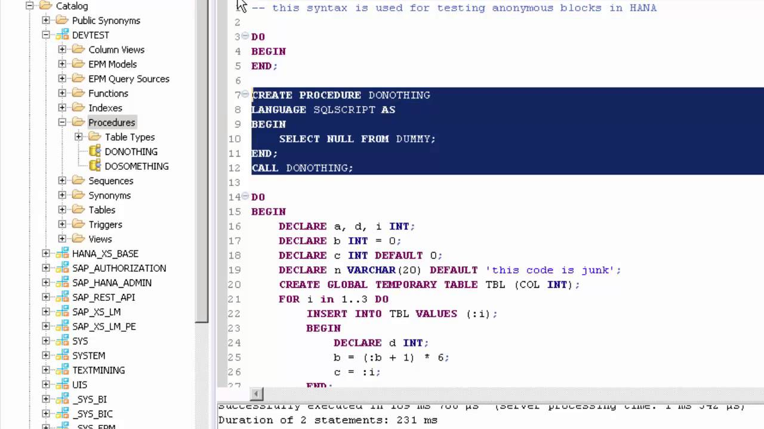
Anonymous Block in HANA
An anonymous block is an executable DML statement which can contain imperative or declarative statements and is defined and executed in a single step. All SQLScript statements, supported in procedures, are also supported in anonymous blocks.

Slide 9
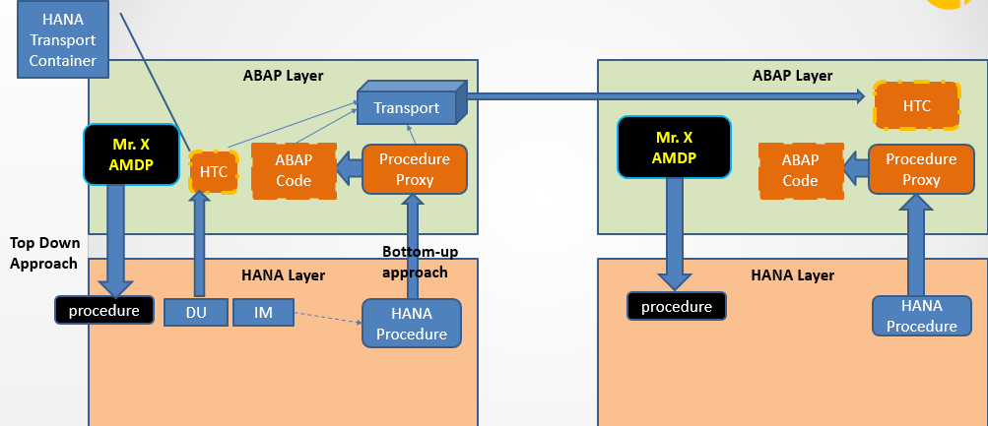
Procedure Proxy
The database procedure proxy defines the mapping between the database types of the parameter interface of the SQLScript procedure and ABAP data types. The following table lists the currently supported HANA-specific data types and indicates which ABAP Dictionary types they are mapped to by default.

Slide 10

Break

Slide 11

What is AMDP
AMDP is a method inside an Normal ABAP Class. These methods are special methods which can contain the SQL Script code.
When we write code, ABAP can tell you the syntax error also (Syntax Check)
When we activate AMDP nothing happens in HANA, But when we call it then it creates a procedure in HANA
We can add SQL Script code inside a method in an ABAP
All the AMDP methods must be static
The same ABAP Class can also contain ABAP Code as well but we cant merge ABAP + SQLScript together
We can call one AMDP from another AMDP
Can an AMDP be debugged?
Can I also implement a FOR ALL ENTRIES like logic using AMDP
Can I pass Select-options to AMDP
Spider bites (Mutation)
Marker Interface –
IF_AMDP_MARKER_HDB
Normal ABAP Class?
SQL Script Code

Slide 12
How to Create AMDP
Add an interface to ABAP class – IF_AMDP_MARKER_HDB
All the AMDP methods has to have parameters passed by Value
We cannot have Returning/ Changing parameters
The method cannot have deep structures
Must also mention the tables which we are planning to use in SQLScript code with a USING keyword
Syntax → METHOD method_name BY DATABASE PROCEDURE FOR HDB LANGUAGE SQLSCRIPT OPTIONS READ-ONLY USING tab1 tab2…
When we call AMDP then it will be created inside HANA
Lifecycle challenges is sorted fully.
Disadvantage:
Client handling
If we plan to use AMDP for DML scenario, The LUW needs to be managed by developer.
If my co. is not on HANA DB we cannot implement AMDP.

Slide 13
ABAP Managed Data Procedure
Methods of global classes marked with tag interface, available since ABAP 7.4 SP05
AMDP classes and AMDP methods
Easy to consume in ABAP – as simple method call
AMDP methods are fully managed on the ABAP server
Source code editing with ABAP Editor (in ADT)
Static syntax check and syntax coloring for SQLScript code
Procedure created on first AMDP call
Detailed analysis of runtime errors in ST22
Transport analog to regular ABAP classes
ABAP Managed Database Procedures
“Top-Down”
Lifecycle
lr_customer->classify( EXPORTING in_date = in_date in_sel = in_sel IMPORTING out_itms = out_itms ).
ABAP Managed DB Procedure
Standard ABAP Transport
AS ABAP
deploy
Stored Procedure
SAP HANA

Slide 14
Integration of Database Procedures into ABAP
Standard ABAP class methods are used as containers for the implementation of AMDPs
Standard ABAP class methods are used as containers for the implementation of AMDPs
Standard ABAP class methods are used as containers for the implementation of AMDPs
CLASS CL_AMDP_SAMPLE DEFINITION.
PUBLIC SECTION.
INTERFACES IF_AMDP_MARKER_HDB. ...
PRIVATE SECTION.
METHODS execute IMPORTING VALUE(it_param) TYPE type1 EXPORTING VALUE(et_param) TYPE type2. ENDCLASS.
CLASS CL_AMDP_SAMPLE IMPLEMENTATION. ...
METHOD execute BY DATABASE PROCEDURE …. -- SQLScript code ENDMETHOD.
ENDCLASS.
Method container for an AMDP

Slide 15
AMDP Method – SQL Script
METHOD classify_by_id BY DATABASE PROCEDURE FOR HDB LANGUAGE SQLSCRIPT OPTIONS READ-ONLY USING SCUSTOM SBOOK.
-- declare local scalar variables declare lc_upper_threshold constant int := 300;
declare lc_lower_threshold constant int := 10; -- translate list of customer ids into id, name ,#of flights … lt_customers = select c.id, c.name, count( s.bookid ) … from scustom … where mandt = :iv_client and c.id in ( select id from :it_customer_id ) group by c.id, c.name;
-- calculate return table et_classification = select id, name,
case when flight_count > :lc_upper_threshold then 1 …
from :lt_customers …
ENDMETHOD.

Slide 16
Feedback
AnubhavTrainings.com :
https://www.anubhavtrainings.com

Slide 17
End of Day 5

Slide 18

Questions

Slide 19

Anubhav Oberoy

